Slide 1


Daily Task Tracker
Python Project Presentation
Made by: Rena Jean Solis

Slide 2

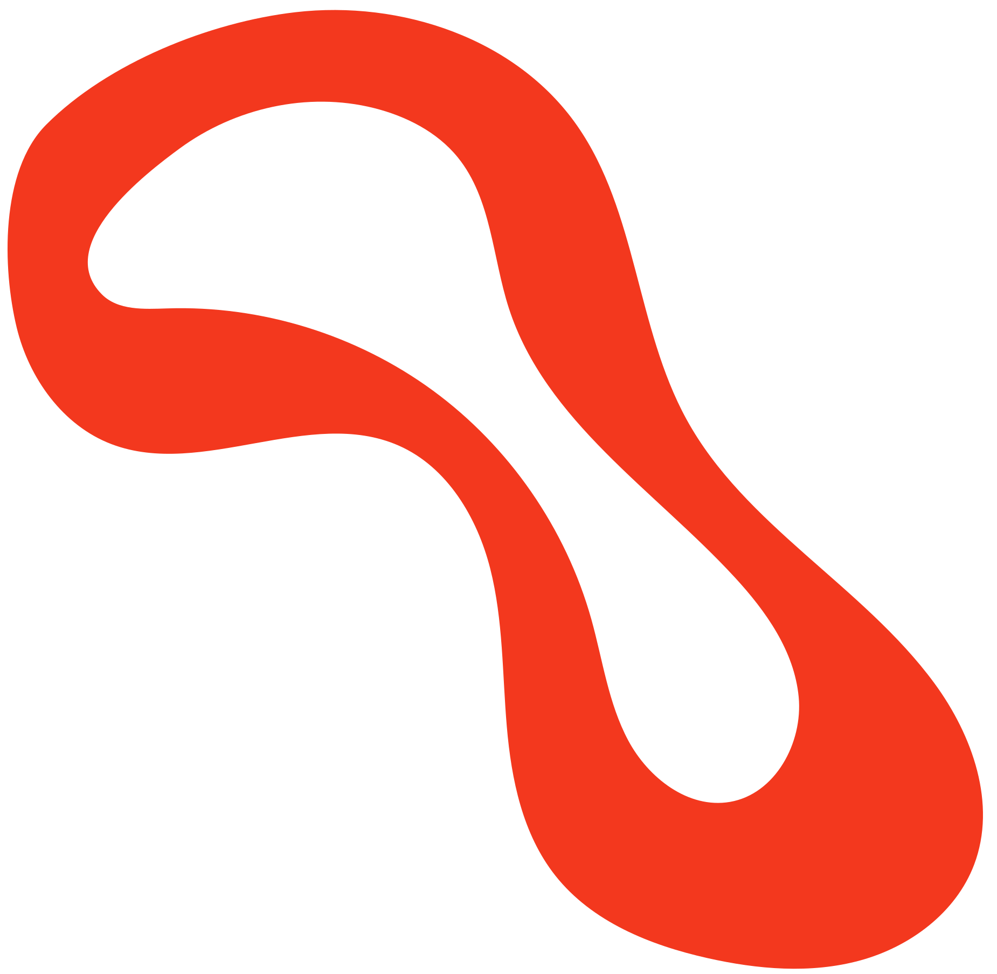
Description
A daily task tracker is a productivity tool used to manage and organize tasks scheduled for completion within a specific day. It helps individuals prioritize tasks, enhance time management, and track progress, ultimately leading to increased efficiency and reduced stress.

Slide 3
Input
Output
Ask: How many tasks?
Ask: Which tasks are done?
(by number input)
User inputs which tasks are completed

Slide 4

Why Grocery List is useful?
A daily task tracker is a useful tool for managing tasks, improving productivity, and enhancing time management. It allows users to organize, prioritize, and monitor their daily activities, leading to better focus, reduced stress, and improved accountability.
Improve Productivity- Helps prioritize tasks and focus on what matter most.
Improves Planning skills- Encourages you to plan your day with intention.
Reduces Stress- Keeps your day organized, reducing mental clutter.
Enhances Time Management- Make it easier to estimate how long things actually take.

Slide 5
Input
Output
User chooses an option:
Marked task status (done/pending)
Summary of completed and missed tasks.
List of daily tasks
Schedule for each task
Process:
User inputs tasks and corresponding times into the system.
Program saves the tasks in a database or list
Option to mark task as “done” or “pending”

Slide 6

End of Presentation

